Slide 1
Topical Clustering of Search Results
Date : 2012/11/8
Resource : WSDM’12
Advisor : Dr. Jia-Ling Koh
Speaker : Wei Chang

Slide 2
Search Results Clustering (SRC)

Slide 3
Outline
Introduction
Approach
Experiment
Conclusion

Slide 4
Syntax and Semantics
How to measure the similarity?
US president issues Libya ultimatum
Barack Obama says Gaddafi may wait out military assault
the paparazzi photographed the star
the astronomer photographed the star

Slide 5
Goal
Find the topics of search results
Measure the similarity between topics
Design a topical clustering algorithm

Slide 6
Search jaguar
Notes:
Topics cluster 是 disjoint 的，但是 snippets 不是

Slide 7
Outline
Introduction
Approach
Experiment
Conclusion

Slide 8
Steps
Find the topics with weight for each snippets
by TAGME
Measure the similarity between topics
Pre-processing
Topical decomposition
Snippets clustering and labeling

Slide 9
TAGME
Get topics with weight from text fragment by Wikipedia
A topic is a Wikipedia page
http://tagme.di.unipi.it/
Response example:
<annotation>
<spot pos="81" len="7">england</spot>
<title>England national football team</title>
<id>9904</id>
<rho>0.3735</rho>
</annotation>
<annotation>
<spot pos="25" len="8">maradona</spot>
<title>Diego Maradona</title>
<id>8485</id>
<rho>0.2112</rho>
</annotation>

Slide 10
Topic relatedness
W
in(t) is the set of in-links in page t
W is the number of all pages in
Wikipedia
rel(t_{a} , t_{b}) is the relatedness
between t_{a} and t_{b}
Assume that in(t_{a}) is bigger than in(t_{b})
in(t_{a} )
in(t_{b} )

Slide 11
Pre-processing
Remove the topics that cover more than 50% of the snippets
Greedily solving a set-covering problem to find a minimum-cardinality subset of topics (pick the topic that contains most weighted yet-uncovered snippets)
T1
T5
T3
T2
T4

Slide 12
Topical decomposition
Partition the subgraph G_{t}
Variables (threshold)
m : max number of cluster
δ_{max} : a cluster have more topics than this value is called big cluster
if (the number of clusters is less than m){
if (there is any big cluster)
bisection the sparsest big cluster
}
Use this algorithm bisection G_{t} each time, then we can partition G_{t} iteratively
Notes:
每個 cluster 的 topic 個數未必只有 δ
問題在於哪個是 sparest 並且 要怎麼切

Slide 13
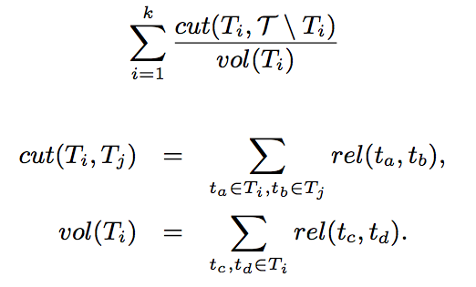
How to bisection?
To minimize the objective function
Use Laplacian matrix

Slide 14
Laplacian matrix
L = D − W
L_{rw} = D⁻¹ L = I - D⁻¹W (L_{rw} is a normalized Laplacian matrix)
Notes:
M 不唯一但是 L 會唯一
Algebraic connectivity 對應的 eigenspace 必定一維

Slide 15
Properties of normalized Laplacian Matrix
L_{rw} is a semi positive matrix
All the eigenvalues 0 = λ₁ ≤ λ₂ ≤ … ≤λ_{n}
The smallest non-zero eigenvalue is called algebraic connectivity
Algebraic connectivity encodes the sparseness of the graph
The corresponding eigenvector is called Fiedler vector
The entry of Fiedler vector represent each node in the graph
Sort and cluster these entry than you can cluster the nodes

Slide 16
Snippets clustering and labeling
Each snippet assign to the corresponding topic cluster
Select the topic in a cluster that most relatedness to snippets
Use the topic title to label the cluster
If the topic title is same as the input query, then use the most frequently used anchor text of the topic
Notes:
交集的分數到底要不要算

Slide 17
Outline
Introduction
Approach
Experiment
Conclusion

Slide 18
Datasets
AMBIENT
Ambiguous Entities
from Yahoo!
44 queries and 100 result snippets for each query (smaller)
OPD-239
from DMOZ directory
239 topics, each with 10 subtopics and about 100 documents(total 25580 documents) (bigger)
each document is composed by a title and a brief description

Slide 19
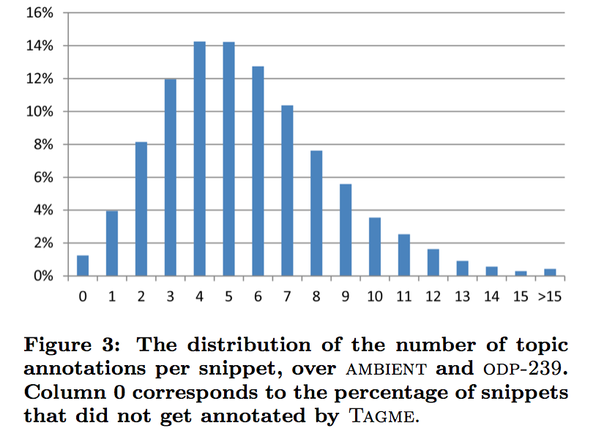
Coverage analysis
Coverage of TAGME
Coverage after pre-processing
Less than 4% snippets have no topic.

Slide 20
F1 measure
Precision , Recall
True-Positives (TP) are the couples of documents of the same class assigned to the same cluster, False-Positives (FP) are the couples of documents of different classes assigned to the same cluster and False-Negatives (FN ) are the couples of documents of the same class as- signed to different clusters.
F1 measure

Slide 21
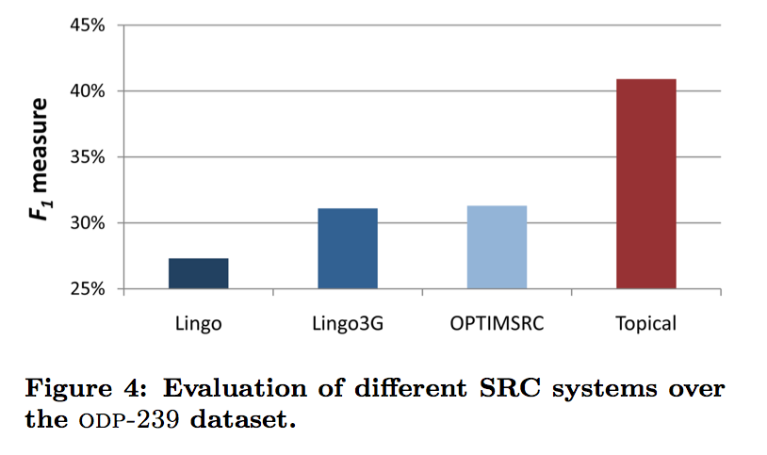
Clustering evaluation(OPD-239)

Slide 22
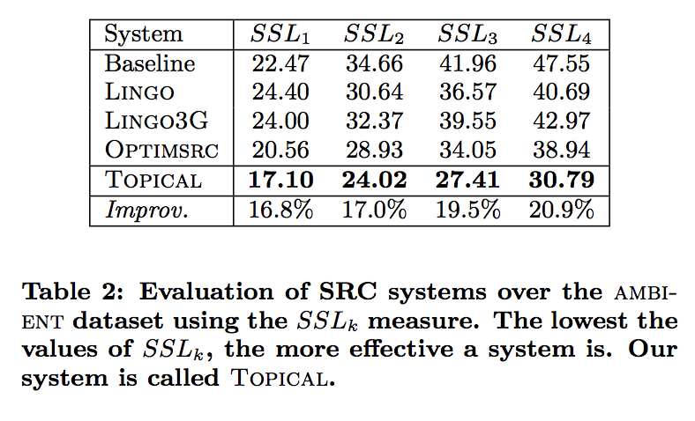
Subtopic retrieval(AMBIENT)
SSL_{k} : average number of items (cluster labels or snippets) that must be examined before finding a sufficient number (k) of documents relevant to any of the query’s subtopics
Clusters are ordered by their size

Slide 23
User study - label diversification

Slide 24
User study - label effectiveness

Slide 25
Outline
Introduction
Approach
Experiment
Conclusion

Slide 26
Conclusion
TAGME has only English and Italian.
We can use distribution system to improve the topic annotation quality.
Laplacian matrix is used in many fields.
We can use a new approach to find just the second eigenvalue and the second eigenvector of the Laplacian matrix.

Slide 27
Thanks for listening

